Slide 1

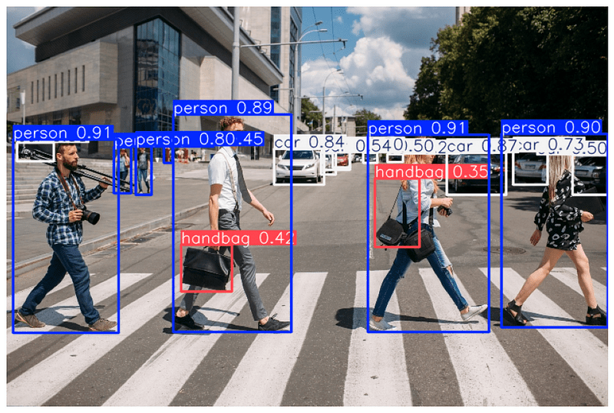
Nail Melanoma Project
Step 1: Nail Detection on Hand Images with YOLO
(Bounding Box Algorithm)
Supervisor: Juan Prada
Second Examiner: Thomas Dandekar
Ayca Öztürk, 2777497

Slide 2
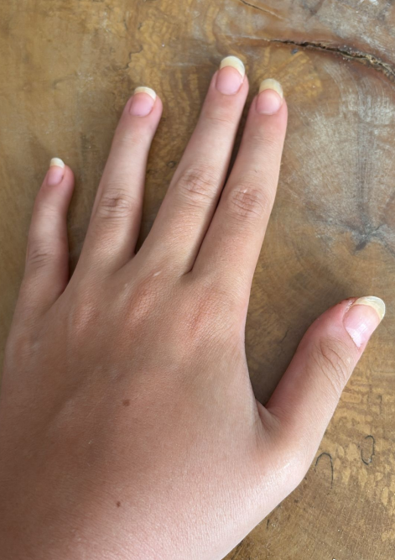
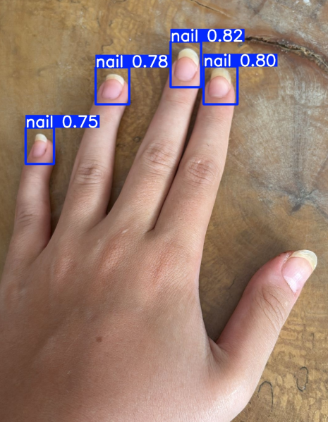
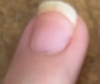
Goal
detecting nails on the hand images to prepare our dataset for nail melanoma analysis
detection tool: YOLOv8
Why YOLO:
fast
accurate for small objects
→
→

Slide 3
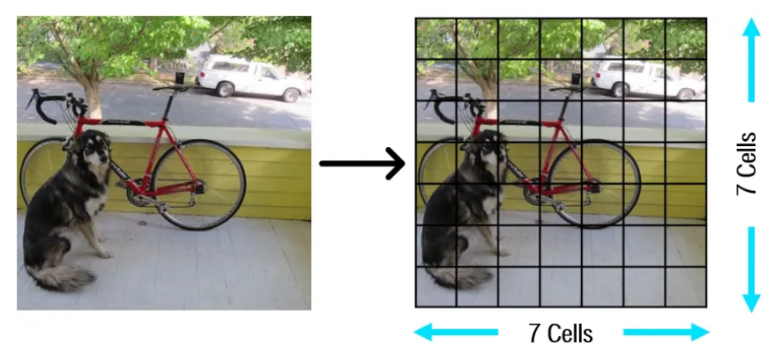
What is YOLO (You Only Look Once)?
Convolutional Neural Network (CNN) based algorithm for object detection
performs detection and classification in a single forward pass → very fast
Grid Division: The input image is divided into an S × S grid. Each grid cell predicts bounding boxes and class probabilities.
Each bounding box includes
(x, y) → center coordinates
(w, h) → width and height
Confidence score → probability of containing an object × accuracy of the box.
Advantages of YOLO:
Speed
Detection accuracy
Good generalization
Open-source

Slide 4
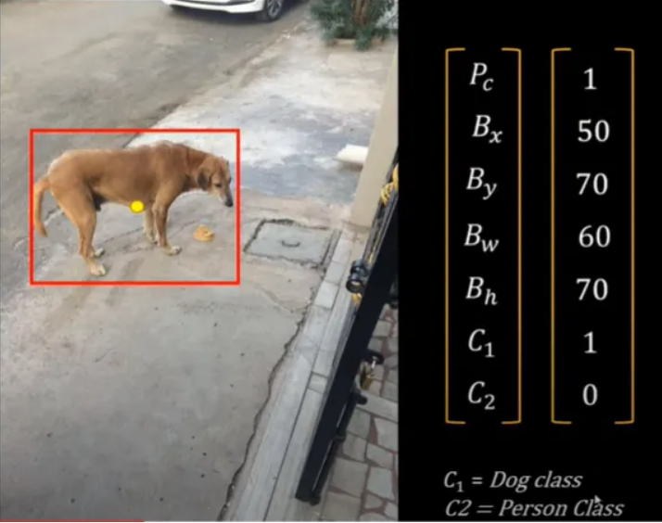
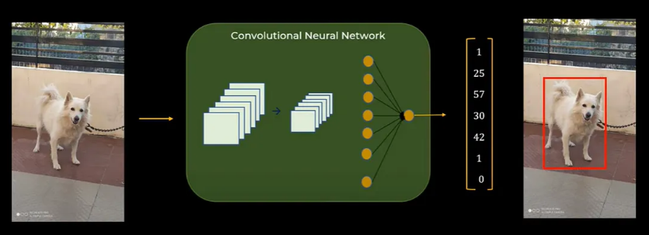
Output Vector (for each object):
Pc (Probability of class): 1, because a dog is detected
Bx: x coordinate of the center of the box (of the object)
By: y coordinate of the center of the box (of the object)
Bw: width of the box
Bh: height of the box
C1: represents dog class
C2: represents person class

Slide 5
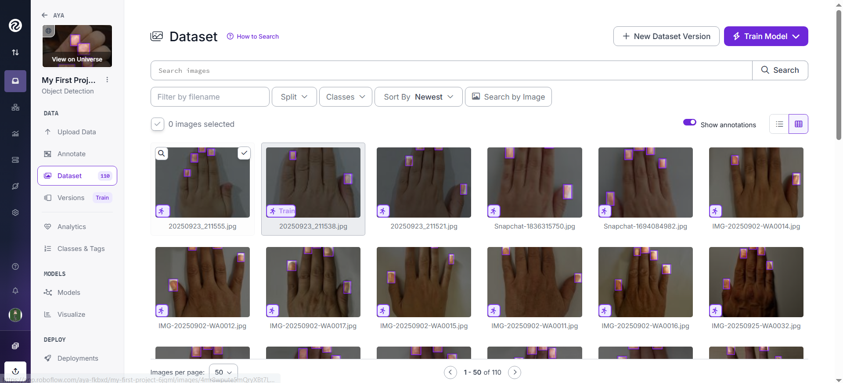
Step 1. Preprocessing: Creating a dataset of hand images from healthy people
110 Images (from friends/family), labeled manuelly in Roboflow (online platform to create/label datasets)
Class: nail
Dataset got exported to YOLOv8 format with label information (coordinates) (train:70 val:20 test:10)

Slide 6
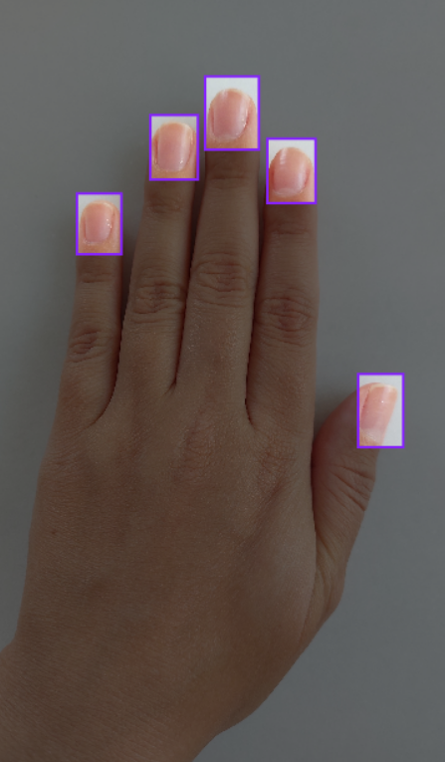
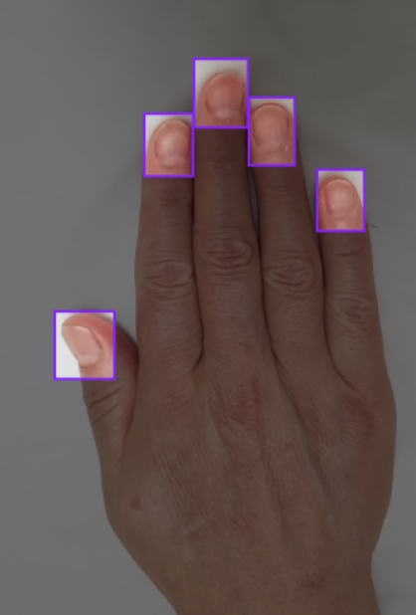
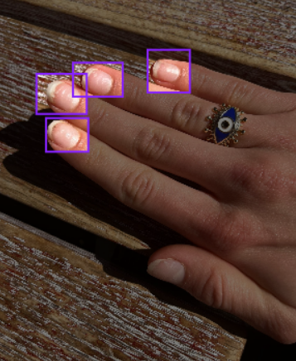
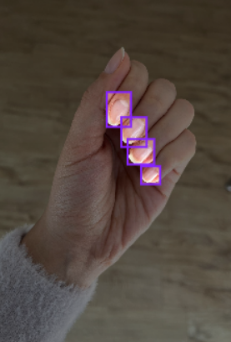
Hand positions
standardized position and white (plain) background → easier to detect
can reduce overfitting

Slide 7
Step 2. Training our model YOLO with different hyperparameters to find the best set of hyperparameters (to find the best trained model)
dataset: 110 images training: 77 validation: 22 test: 11
optimizer: auto conf: 0.1 lr0=0,01
 | epochs | batch | imgsz
1 | 20 | 8 | 640
2 | 20 | 16 | 640
3 | 20 | 32 | 640
4 | 50 | 8 | 640
5 | 50 | 16 | 640
6 | 50 | 32 | 640
7 | 100 | 8 | 640
8 | 100 | 16 | 640
9 | 100 | 32 | 640
Epoch: One full pass of the entire training dataset. ↑ improves until plateu, risk of overfitting, slower ↓ faster, risk of underfitting
Batch: A small subset of dataset processed together before updating the model. ↑ smoother gradients (how much the loss changes), fewer steps, ↓ noisier gradients, more steps

Slide 8
Result Images (Validation Sets) with confidence scores

Slide 9
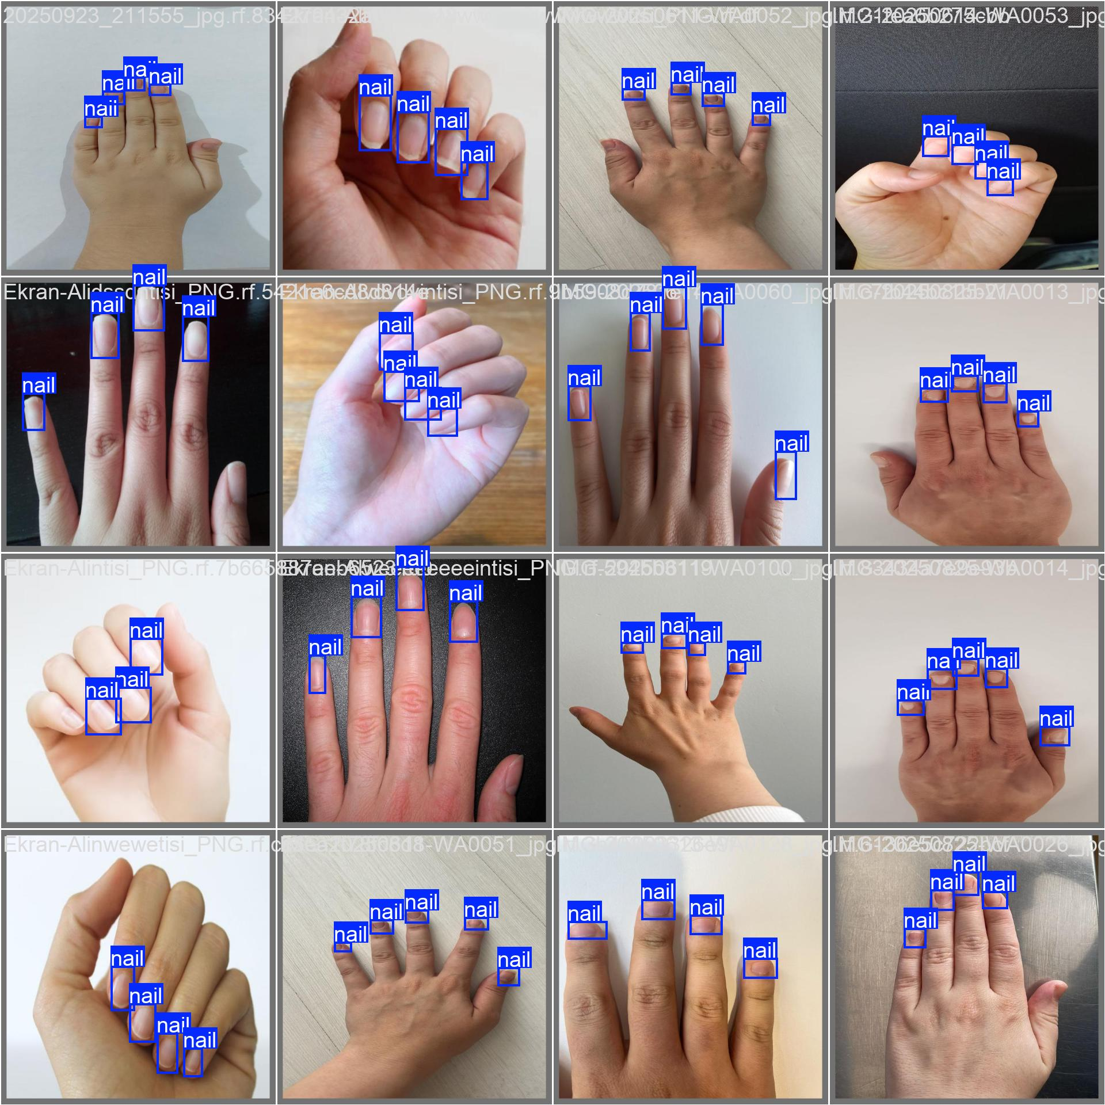
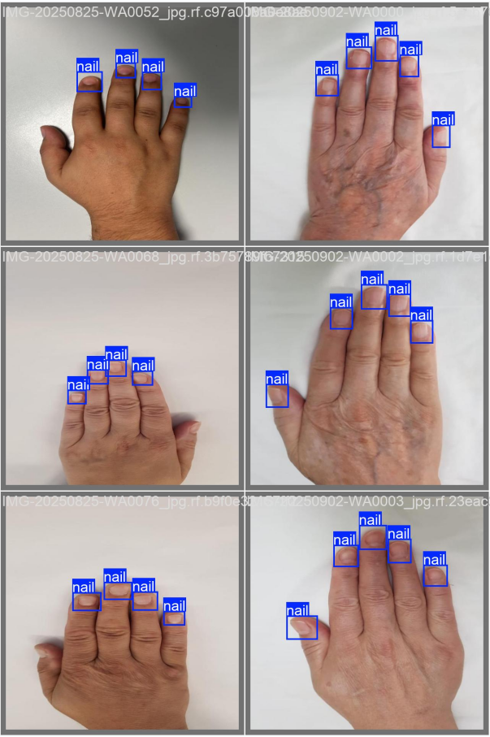
Experiment 1: epochs: 20 batch: 8 imgsz: 640

Slide 10
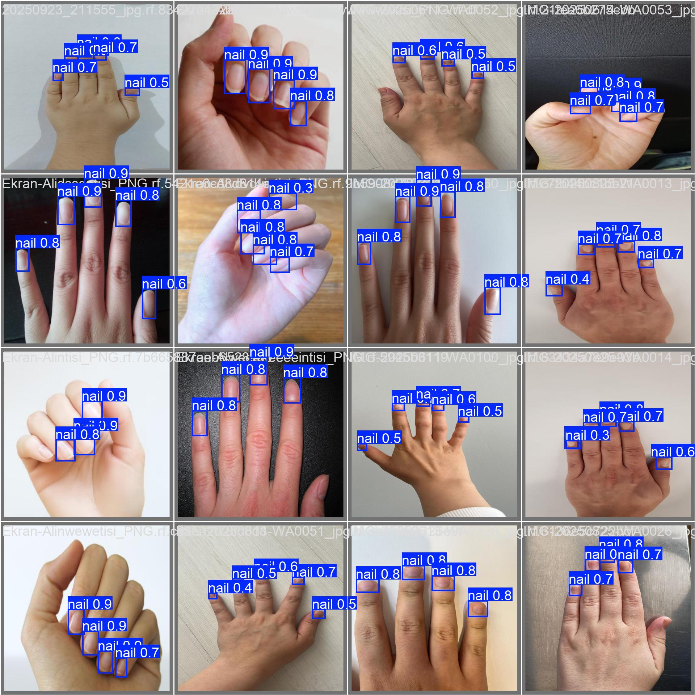
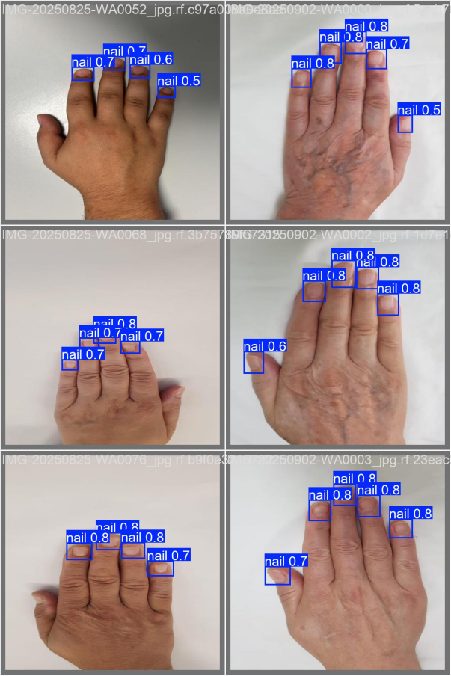
Experiment 1: epochs: 20 batch: 8 imgsz: 640

Slide 11
Experiment 2: epochs: 20 batch: 16 imgsz: 640

Slide 12
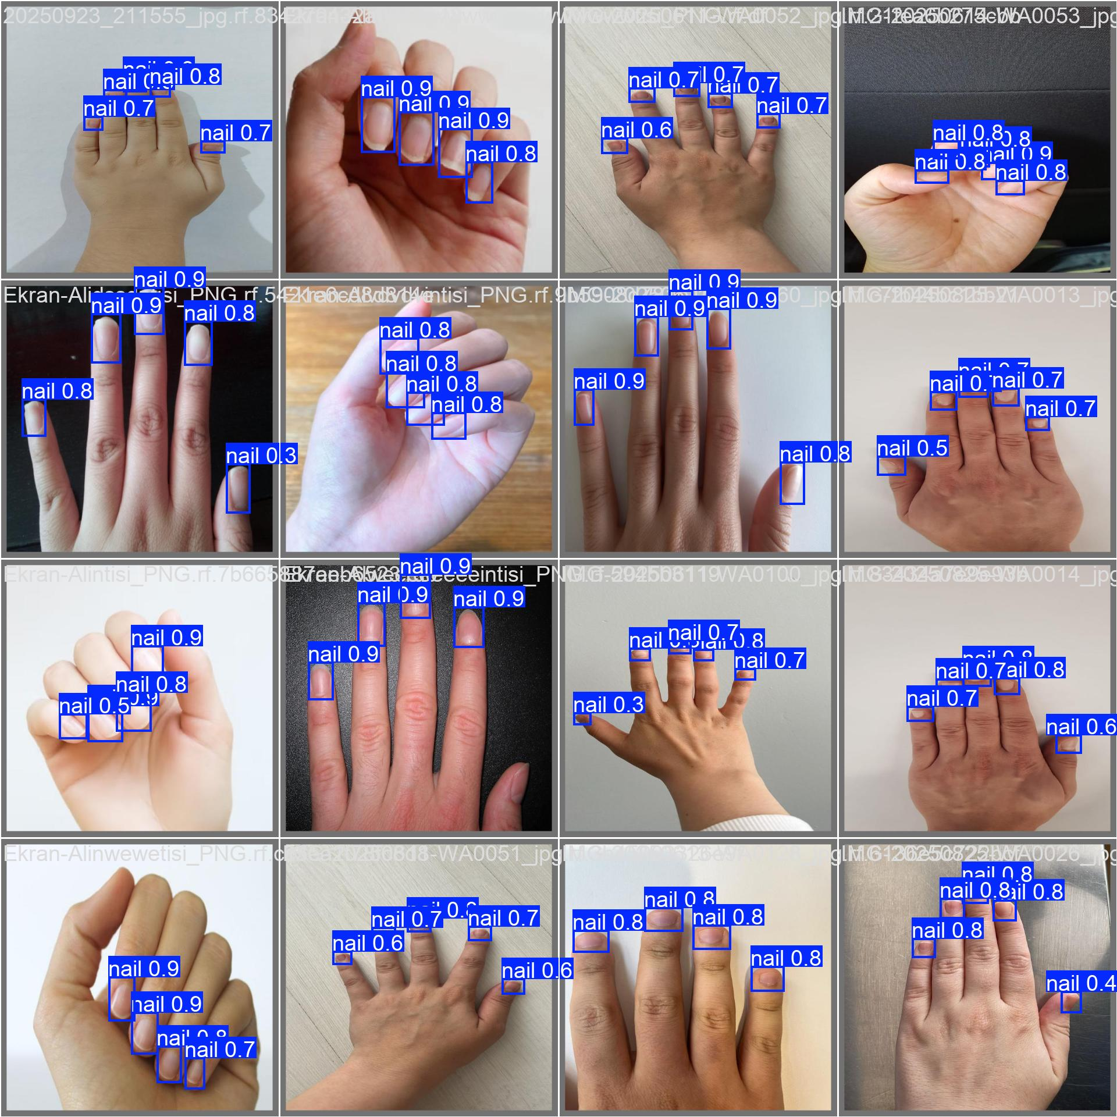
Experiment 2: epochs: 20 batch: 16 imgsz: 640

Slide 13
Experiment 3: epochs: 20 batch: 32 imgsz: 640

Slide 14
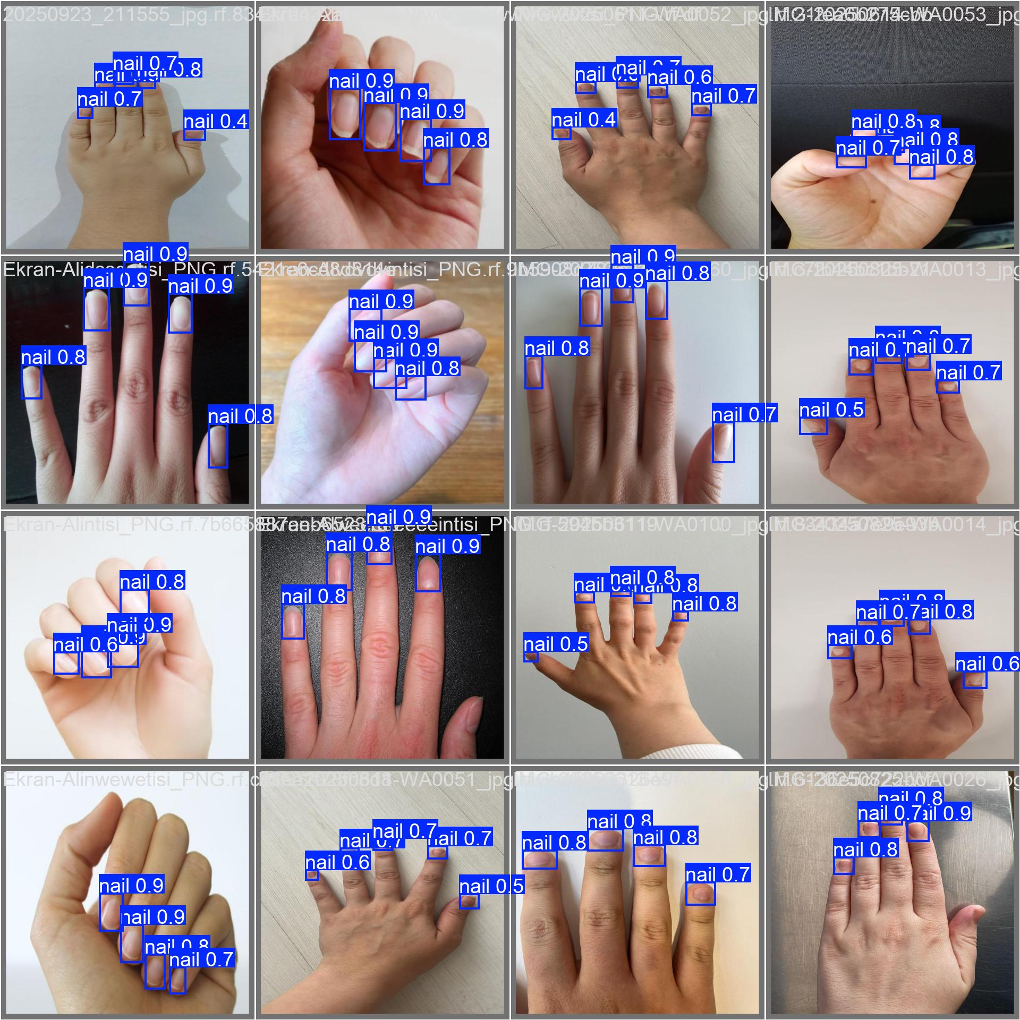
Experiment 3: epochs: 20 batch: 32 imgsz: 640

Slide 15
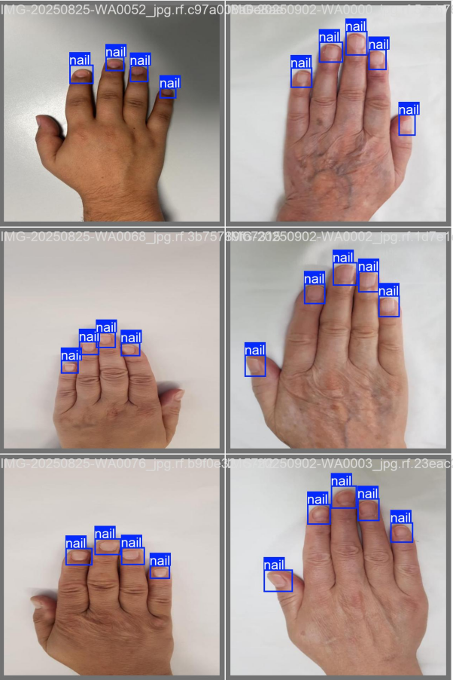
Experiment 4: epochs: 50 batch: 8 imgsz: 640

Slide 16
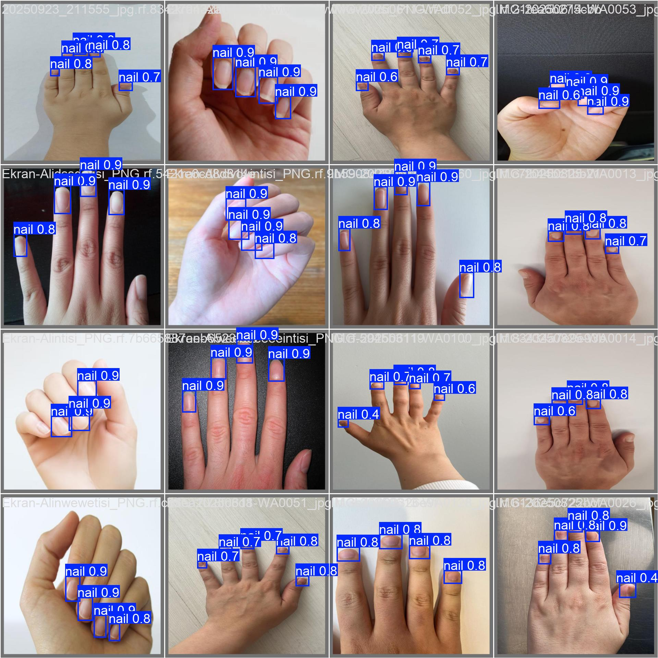
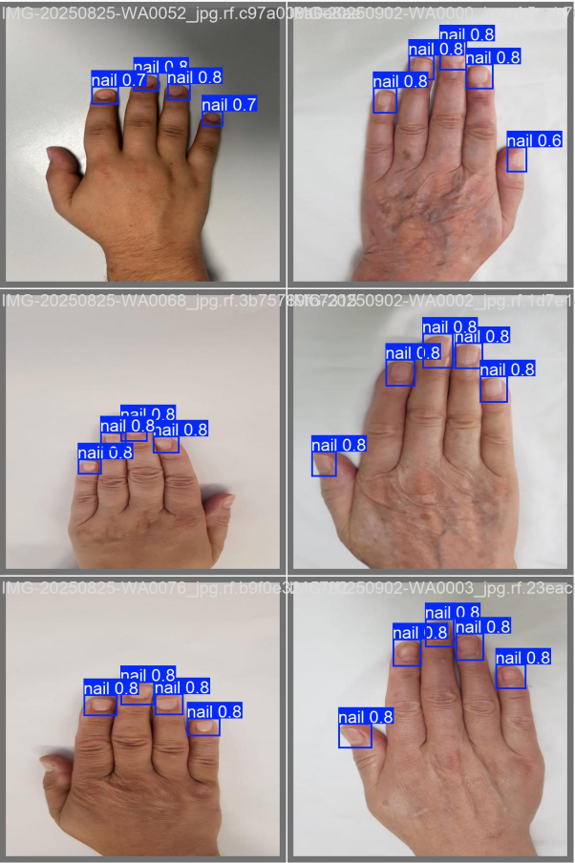
Experiment 4: epochs: 50 batch: 8 imgsz: 640

Slide 17
Experiment 5: epochs: 50 batch: 16 imgsz: 640

Slide 18
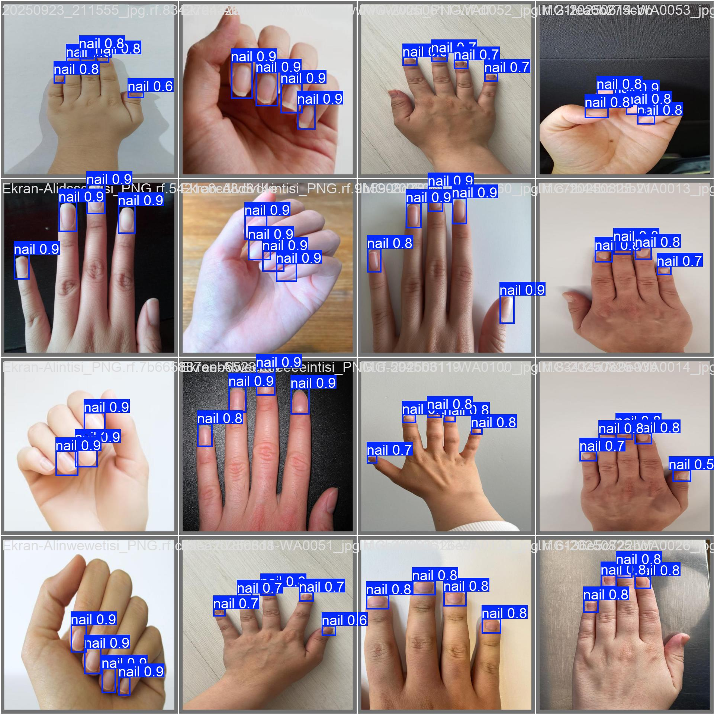
Experiment 5: epochs: 50 batch: 16 imgsz: 640

Slide 19
Experiment 6: epochs: 50 batch: 32 imgsz: 640

Slide 20

Experiment 6: epochs: 50 batch: 32 imgsz: 640

Slide 21
Experiment 7: epochs: 100 batch: 8 imgsz: 640

Slide 22

Experiment 7: epochs: 100 batch: 8 imgsz: 640

Slide 23
Experiment 8: epochs: 100 batch: 16 imgsz: 640

Slide 24
Experiment 8: epochs: 100 batch: 16 imgsz: 640

Slide 25
Experiment 9: epochs: 100 batch: 32 imgsz: 640

Slide 26
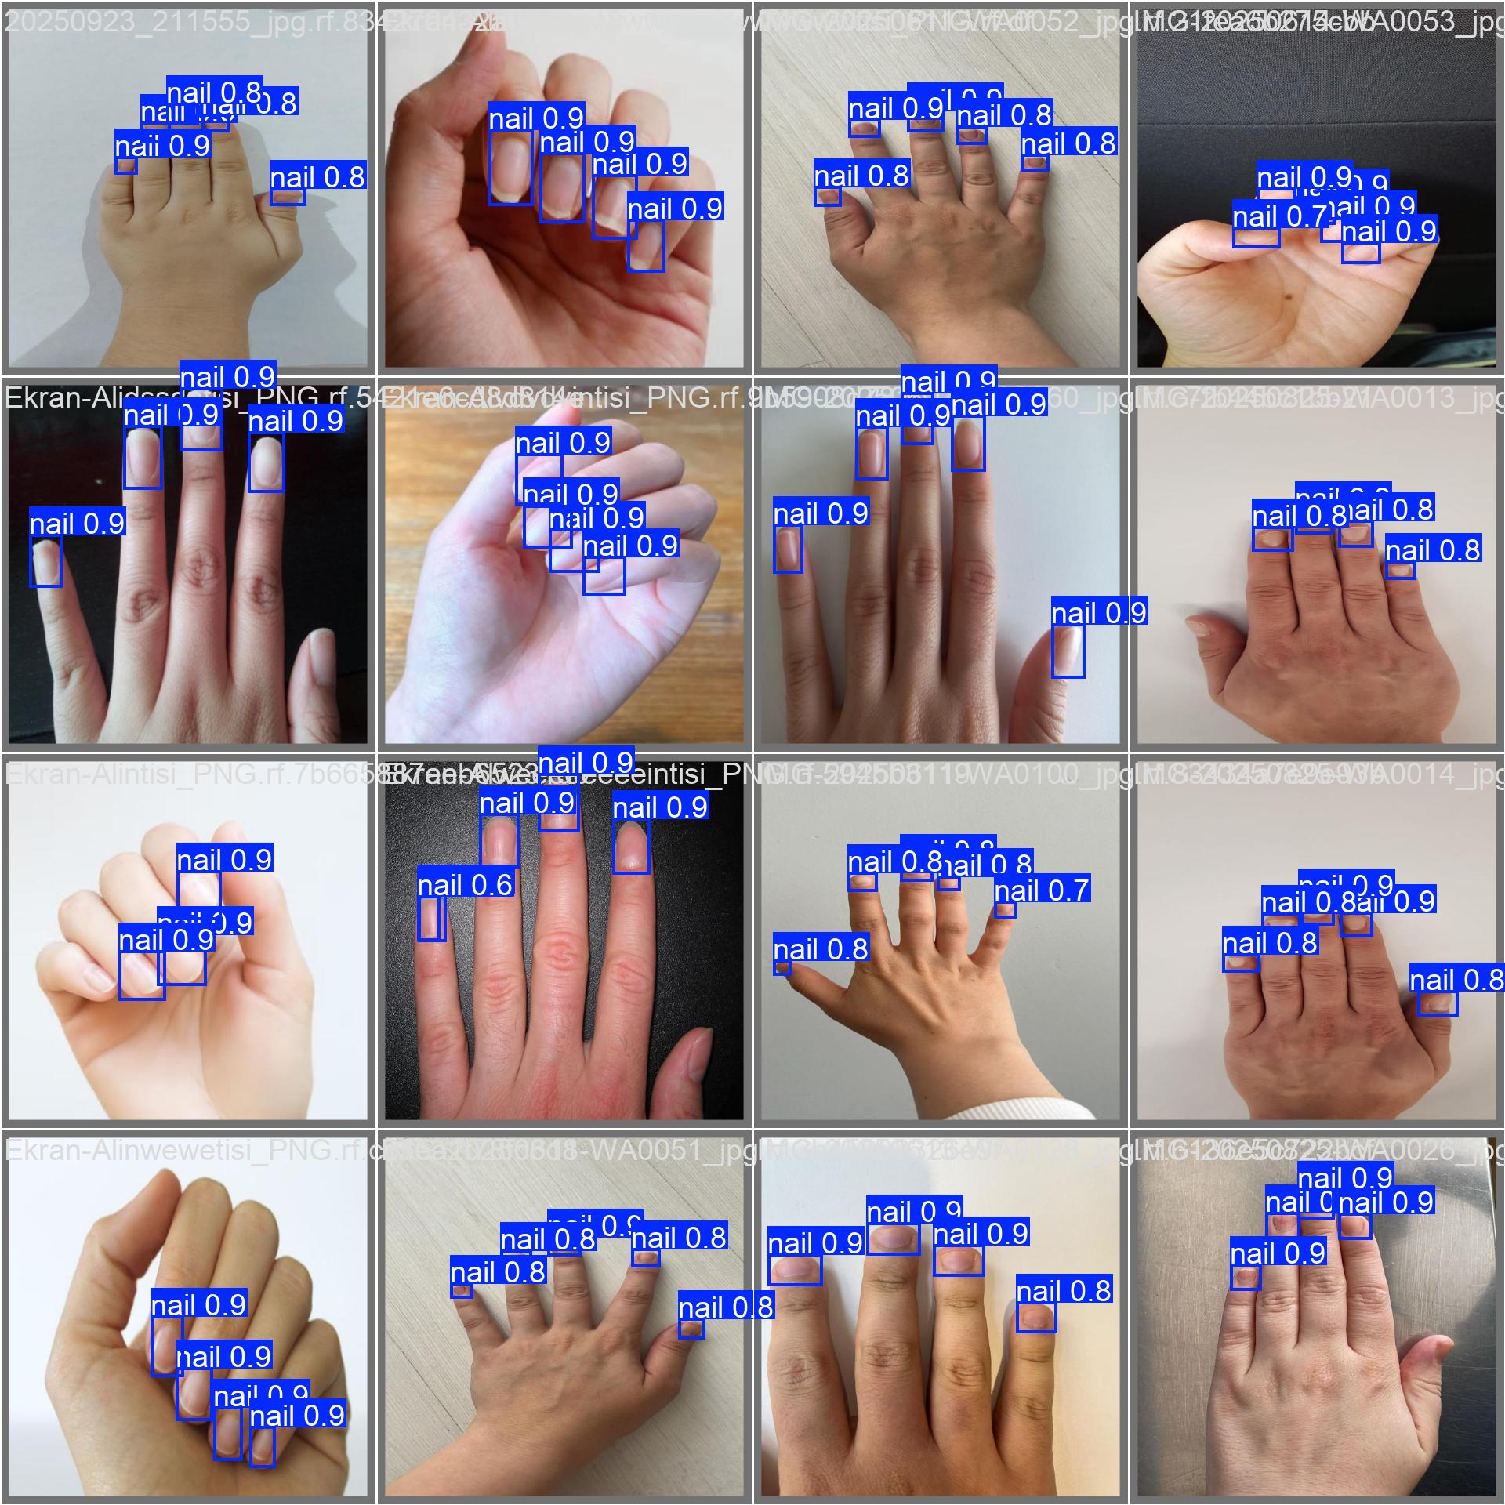
Experiment 9: epochs: 100 batch: 32 imgsz: 640

Slide 27
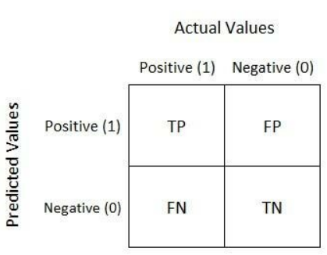
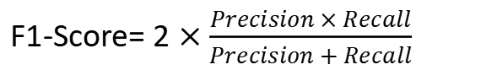

Metrics
Precision: How often the model is correct when it predicts a positive. ↑ few false positives
Recall: How many of the actual positives the model finds. ↑ few missed positives
F1-score: Single number that balances Precision and Recall (harmonic mean) ↑ good balance
Precision = $\frac{TP}{TP+FP}$​
Recall = $\frac{TP}{TP+FN}$
F1-Score= 2 $×\frac{Precision × Recall}{Precision + Recall}$
Confusion Matrix: table that shows how well a classification model performs by comparing the true labels with the predicted labels.

Slide 28
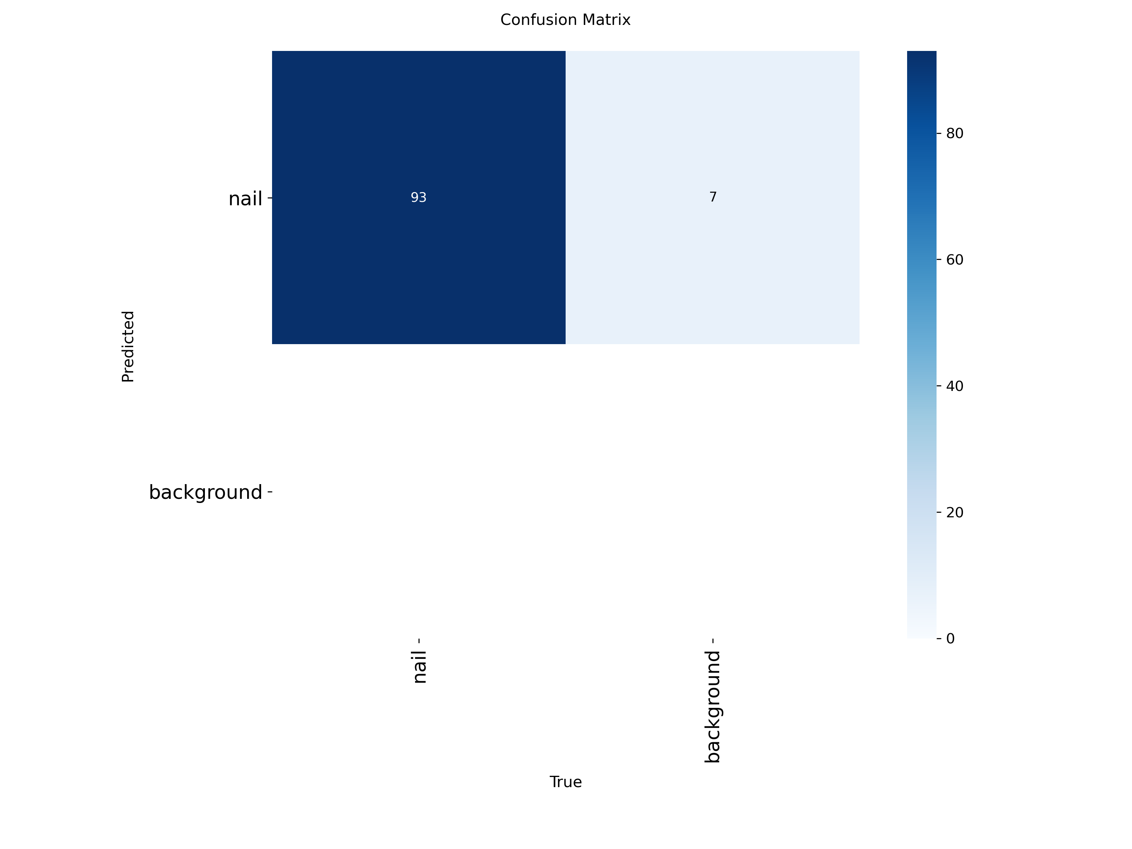
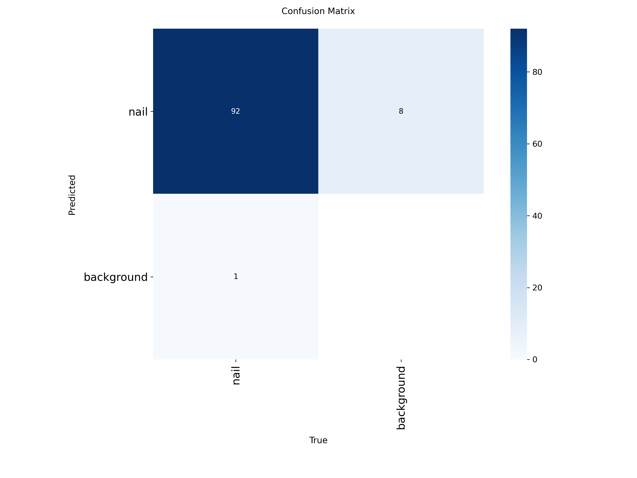

Confusion Matrices
Experiment 1: epochs: 20 batch: 8 imgsz: 640
Experiment 2: epochs: 20 batch: 16 imgsz: 640

Slide 29
Confusion Matrices
Experiment 3: epochs: 20 batch: 32 imgsz: 640
Experiment 4: epochs: 50 batch: 8 imgsz: 640

Slide 30


Confusion Matrices
Experiment 5: epochs: 50 batch: 16 imgsz: 640
Experiment 6: epochs: 50 batch: 32 imgsz: 640

Slide 31

Confusion Matrices
Experiment 7: epochs: 100 batch: 8 imgsz: 640
Experiment 8: epochs: 100 batch: 16 imgsz: 640

Slide 32

Confusion Matrices
Experiment 9: epochs: 100 batch: 32 imgsz: 640

Slide 33
Precision, Recall and F1-Scores from the Confusion Matrices
dataset: 110 images training: 77 validation: 22 test: 11
optimizer: auto conf: 0.1 lr0=0,01
 | epochs | batch | precision | recall | F1-Score
1 | 20 | 8 | 0,93 | 1 | 0,963
2 | 20 | 16 | 0,92 | 0,989 | 0,954
3 | 20 | 32 | 0,93 | 1 | 0,963
4 | 50 | 8 | 0,948 | 0,989 | 0,968
5 | 50 | 16 | 0,969 | 1 | 0,984
6 | 50 | 32 | 0,968 | 0,989 | 0,979
7 | 100 | 8 | 0,958 | 0,989 | 0,972
8 | 100 | 16 | 0,958 | 0,989 | 0,973
9 | 100 | 32 | 0,949 | 1 | 0,974
Epoch: One full pass of the entire training dataset.
Batch: A small subset of dataset processed together before updating the model.

Slide 34
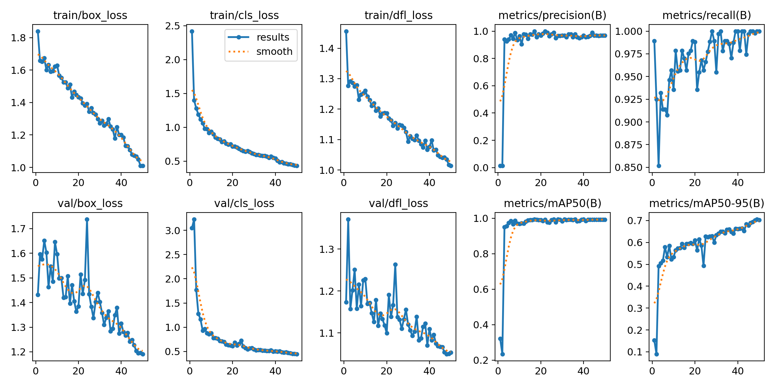
Results of Experiment 5 (epochs: 50, batch:16):
train and validation losses decrease → model learns effectively with minimal overfitting
high precision and recall values → few false positives (correctly detected nails) and few false negatives (detects nearly all nails)
map@50≈ 1 and map@50-95≈0,7 → high accuracy
Conclusion: model is well trained, generalizes effectively and has a high detection accuracy

Slide 35
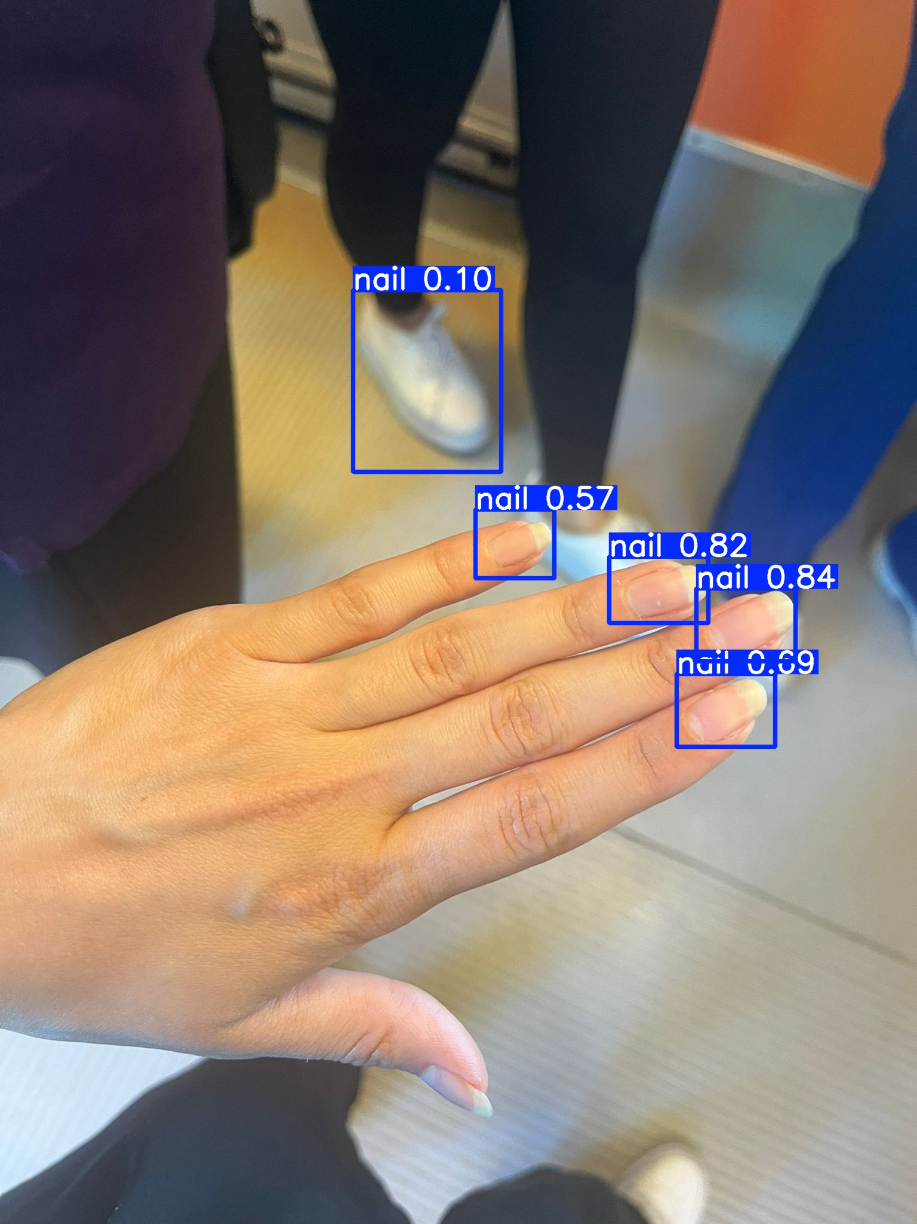
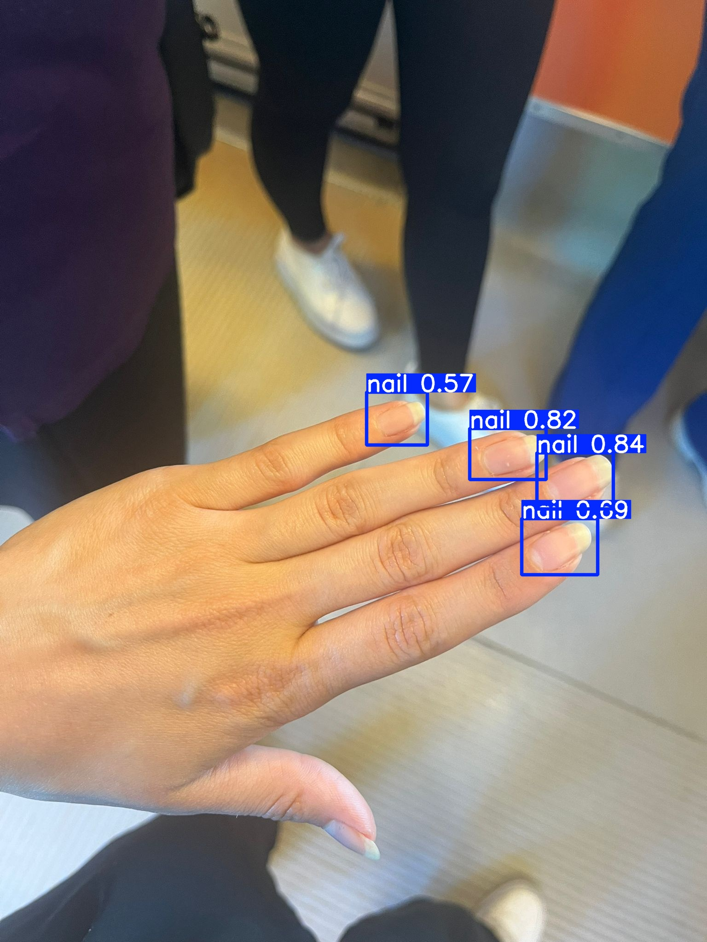
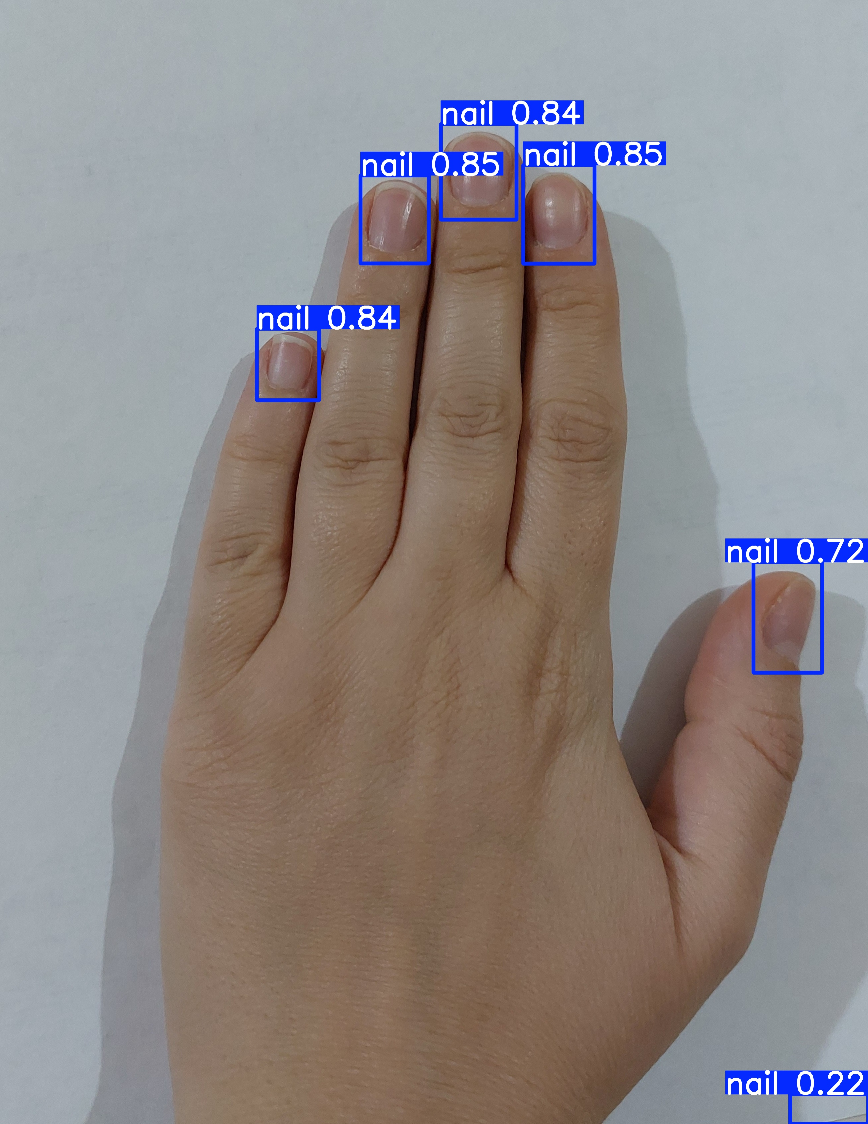
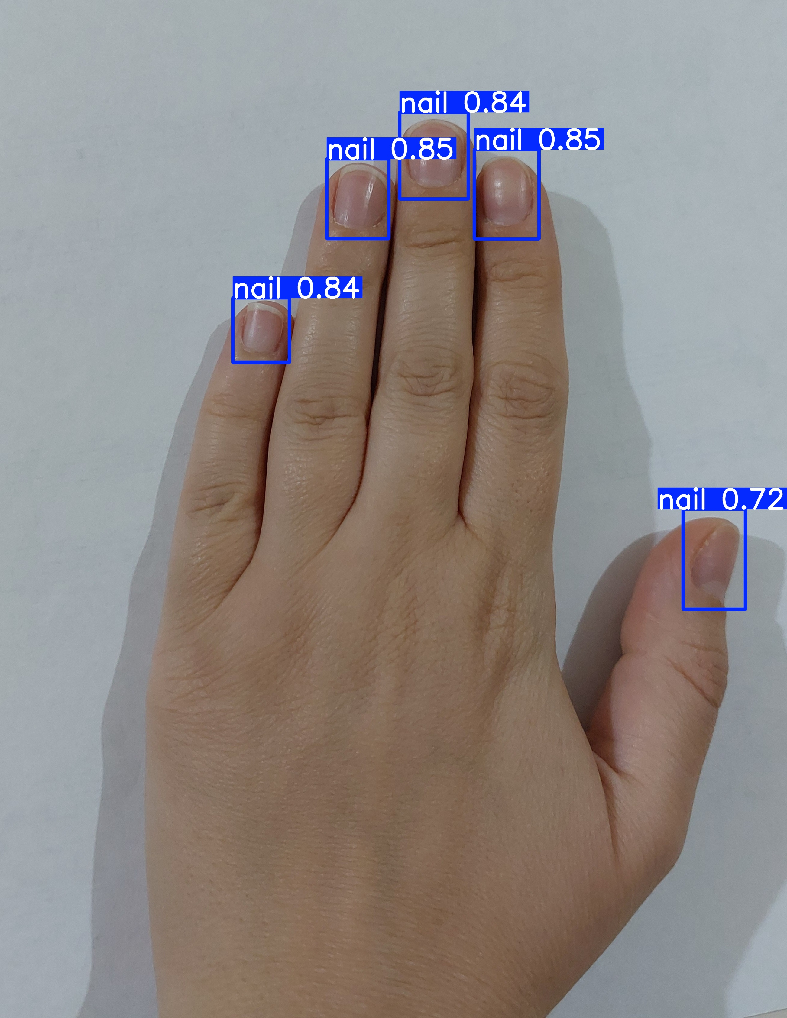
Confidence Score
how sure the model is about its prediction.
lower treshold: detects more objects, but also more mistakes
higher treshold: detects fewer objects, but more accurate ones
conf=0.1 conf=0.2 conf=0.2 conf=0.3

Slide 36
Thank you for your attention and for your support...

